Slide 1
A Database about Corona-virus effected people in Bangladesh.
Presented By:
Mir Arnab Kabir (ID: 18201018)
Nowshin Islam Nova (ID: 18201015)

Slide 2
Introduction:
The coronavirus COVID-19 pandemic is the defining global health crisis of our time and the greatest challenge for us now. To fight against this virus , we need to observe all the information about it. And a Database System is a great way to know and collect information about it . Here we have made an Database system about this virus how this is effecting in Bangladesh.

Slide 3
Motivation:
The COVID-19 pandemic is a rapidly evolving situation and information about the virus is still emerging. This is the kind of information which people need to know in their everyday life now. Everyday we need to know how many people are positive on a particular day, if the number of patients is increasing or decreasing , in which place the virus is spreading more or less, which ages people are suffering more or less etc. In order to know all this kind of information a Database System is in necessity now. We can know about ever days information here. As this information is now daily needed so a Database System about it will make this easy for a user to collect info. That motivates us to create a Database System about coronavirus updates in Bangladesh. Here all the users can easily access any information about anything, regarding the current situation in Bangladesh.

Slide 4
What information’s we have here?
Total Tests , Total Cases , number of male and freemale in every District in Bangladesh.
Per Day , Per Week and Per Month Information.
Treatment Information. Like how many Covid hospital , Total bed for Covid patients and Logistics Situation.
Effected percentage by every age.

Slide 5
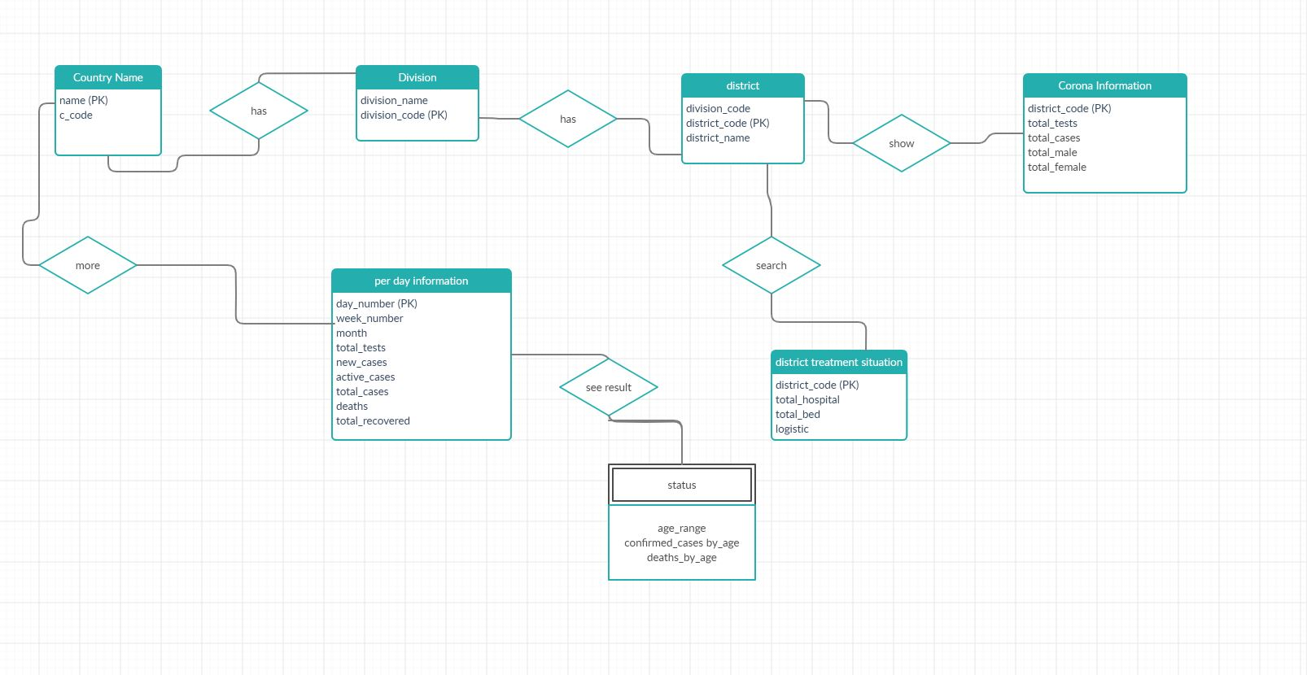
E-R Diagram:

Slide 6
DML & DDL Statements:
Creating Database:
CEATE TABLE district {
division_code int(2),
District_Code varchar(5),
District_name varchar(15),
primary key (District_Code)
}
Inserting Data:
INSERT INTO `district information` (`division_code`, `District_Code`, `District_Name`, `Total_Tests`, `Total_Cases`, `Number_of_Male`, `Number_of_Female`) VALUES ('60', '3100', 'Sylhet', '26,884', '6,884', '3,609', '3,275');
INSERT INTO `district treatment situation` (`District_Code`, `total_hospital`, `total_bed`, `logistics`) VALUES ('3100', '5', '206', 'Good’);
Deleting:
DELTE FROM division
WHERE division_code = 40 ;
Updating:
UPDATE `per_day_information` SET `new_cases` = '568', `deaths` = '168 (New 5)', `total_recoverd` = '10' WHERE `per_day_information`.`day_number` = 'Apr 30';

Slide 7
Now, we will see some selected query from the database. Which is already saved in an another document. Link: https://rb.gy/rlgjgg And that's all . Thank you everyone.

